Slide 1
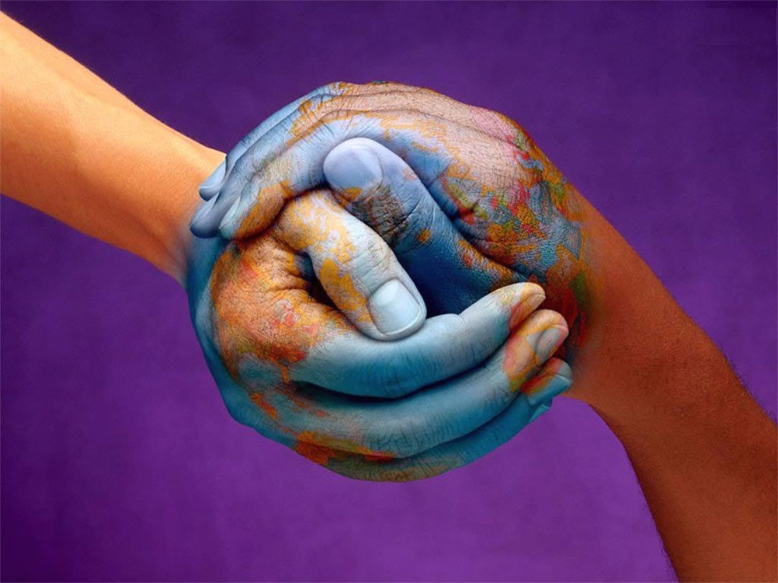
The world is your oyster

Slide 3
Holiday activities * meet the locals * see famous landmarks * have time to yourself * buy souvenirs * try the local cuisine e.g. While on * practise the language holiday, I … * visit museums * visit local markets * lie on the beach all day * explore nature * go on guided tours

Slide 4
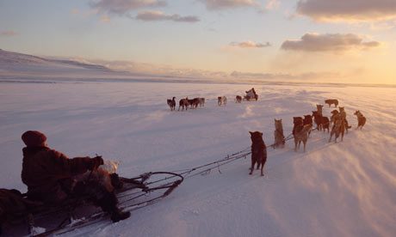
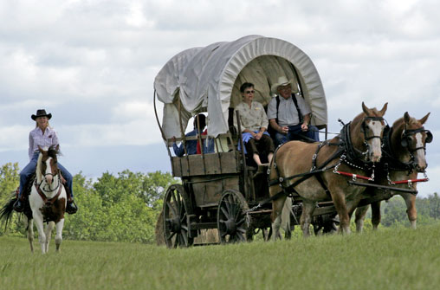
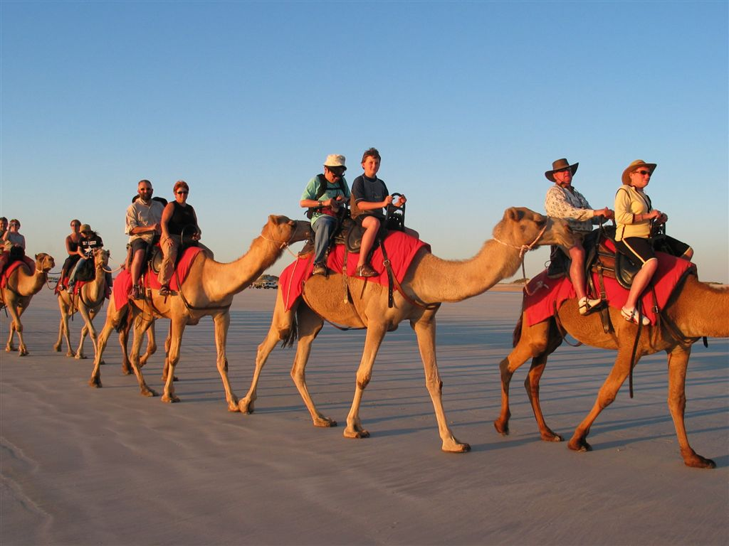
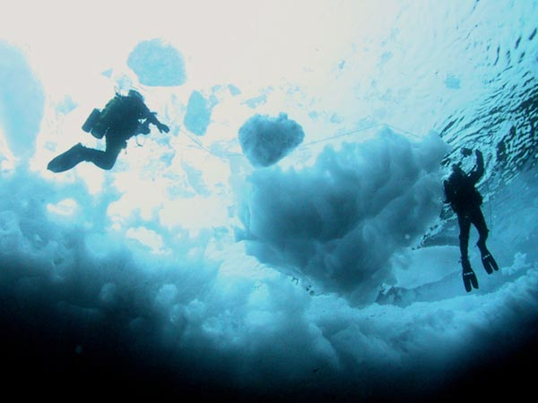
Sledding in Russia Wagon Travel in Wyoming Camel Riding in Morocco Ice Diving in the Arctic

Slide 5
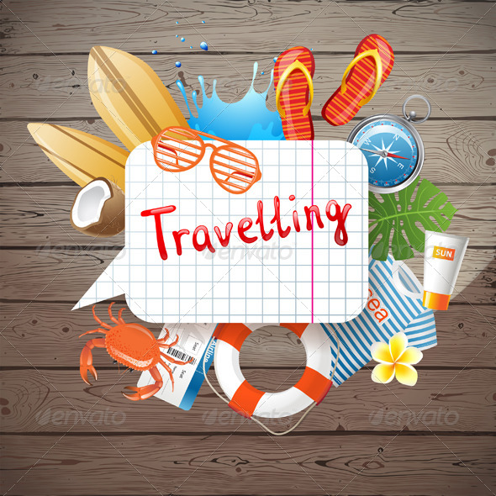
native varied wonder unique unspoilt majestic beneath snap

Slide 6
